Slide 1


COVID Affected Crime Rates in South Australia
Presented by Keyboard_Crime_Warriors
Anna Josh Tealiie Zohaib

Slide 2
Introduction
Hypothesis
Covid affected crime rates in South Australia in 2020

Slide 3
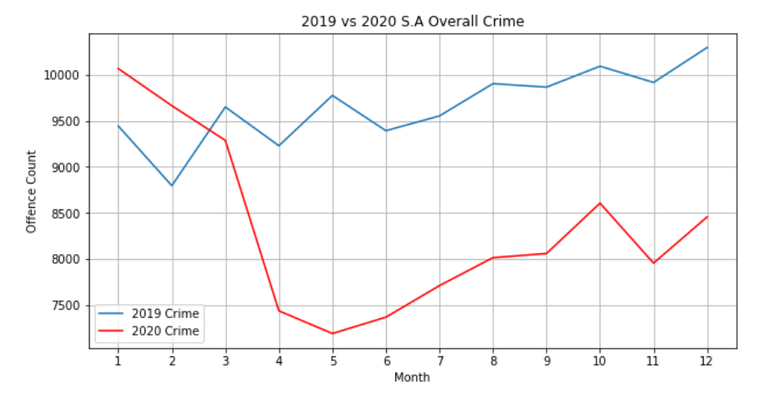
Overall Crime

Slide 4
Crime Types (Property)
Crimes
Property
Fraud Deception
Property Damage
Person
Serious Criminal Trespass
Theft
Obtain Benefit
Other Fraud
Graffiti
Other Property Damage
Property Damage by fire
Unlawfuly entry with intent
SCT Residence
SCT Non-Residence
Theft from MV
Theft from Shop
Theft/Illegal use of MV
Other theft
Receive or Handle proceeds of crime

Slide 5
Crime Types (Personal)
Crimes
Property
Person
Act intended to cause injury
Assault Police
Common Assault
Homicide
Murder
Other homicide
Other Offences
Abduction/harassment
Dangerous or negligent act
Threatning behaviour
Robbery
Aggravated
Blackmail / exortion
Non-aggravated
Sexual Assault
Other act intended to cause injury
Serious Assault resulting injury
Serious Assault not resulting injury
Aggravated
Non Aggravated
Non assaultive

Slide 6
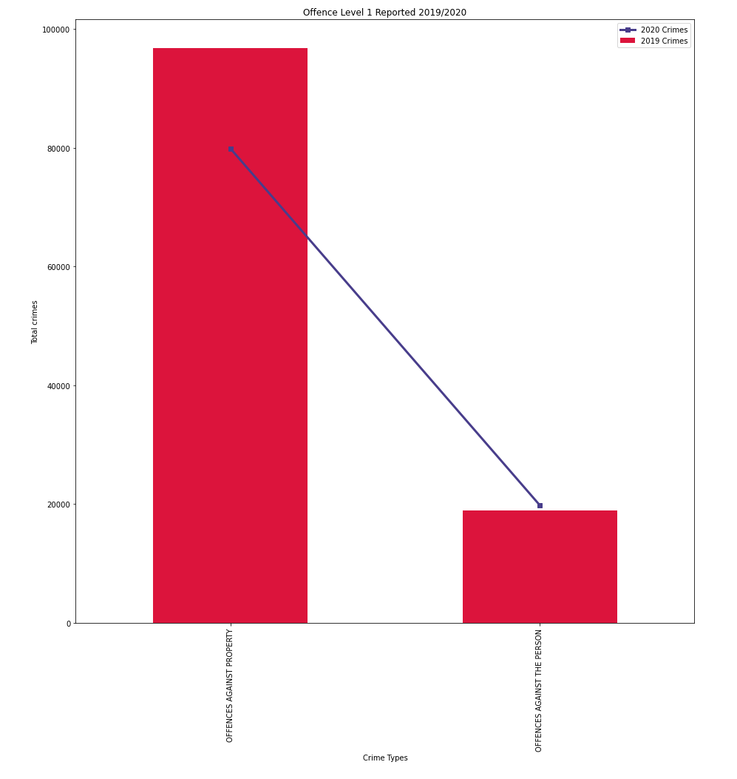
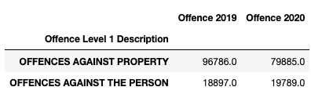
Offence Type Level 1 2019 vs. 2020

Slide 7
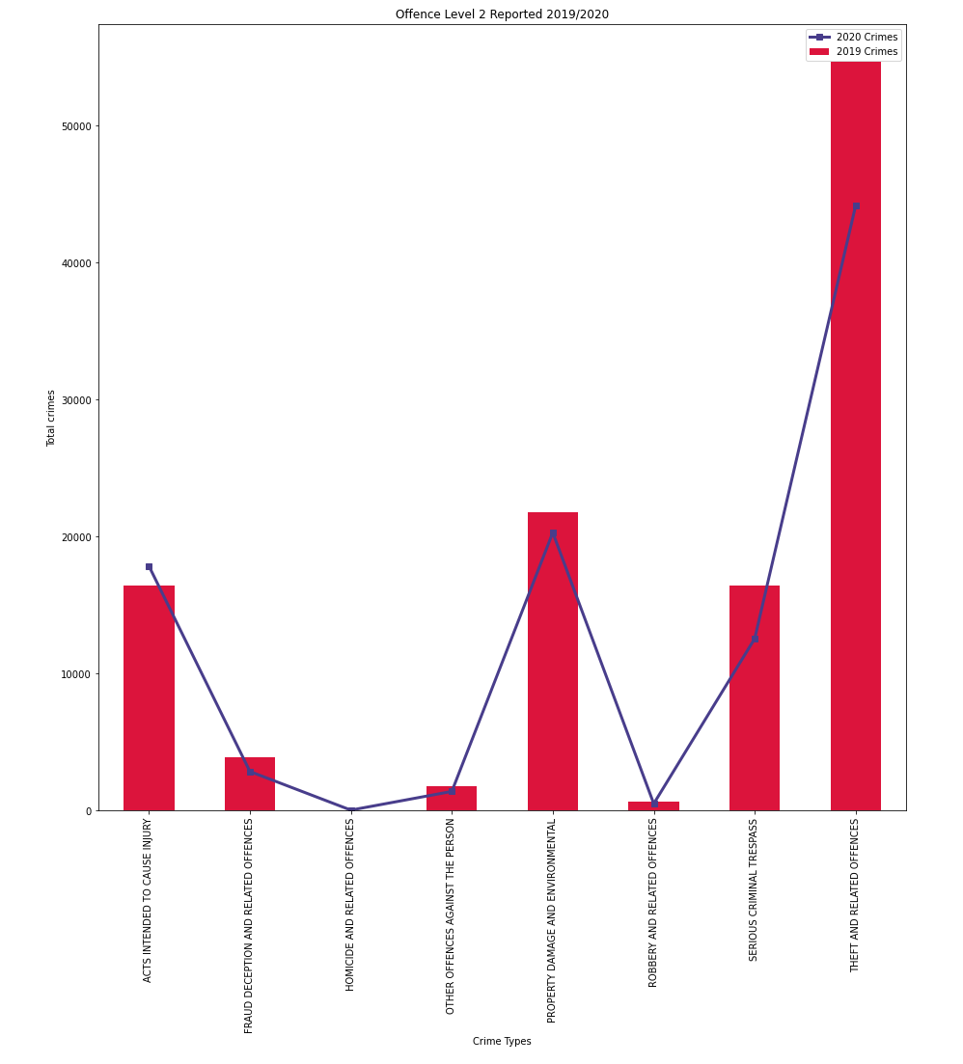
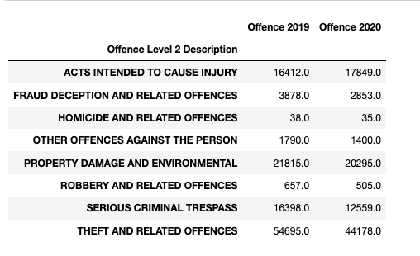
Offence Type Level 2 2019 vs. 2020

Slide 8
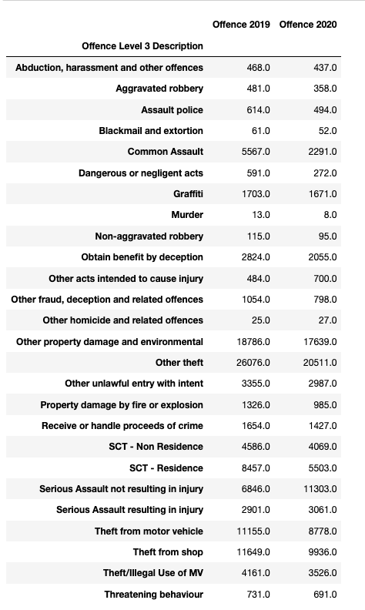
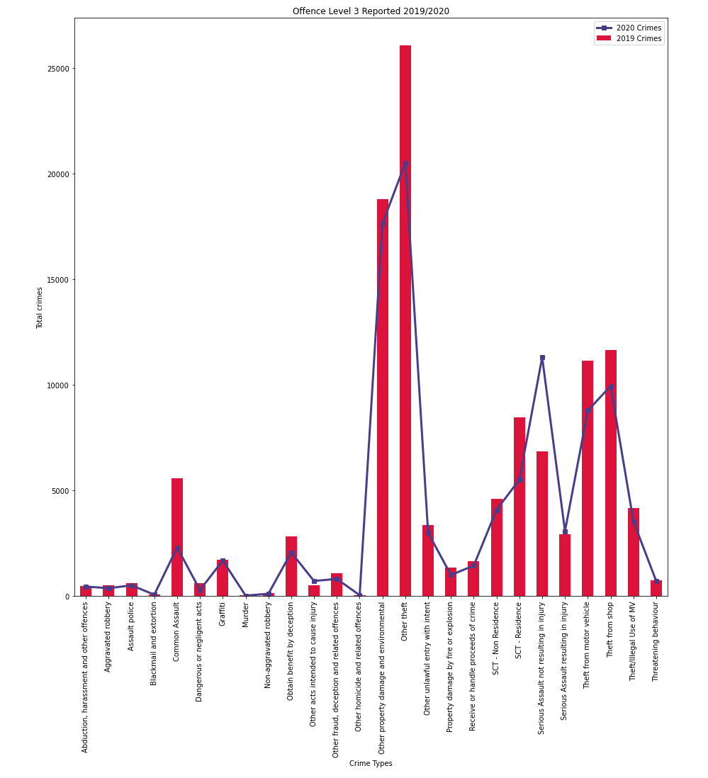
Offence Type Level 3 2019 vs. 2020

Slide 9
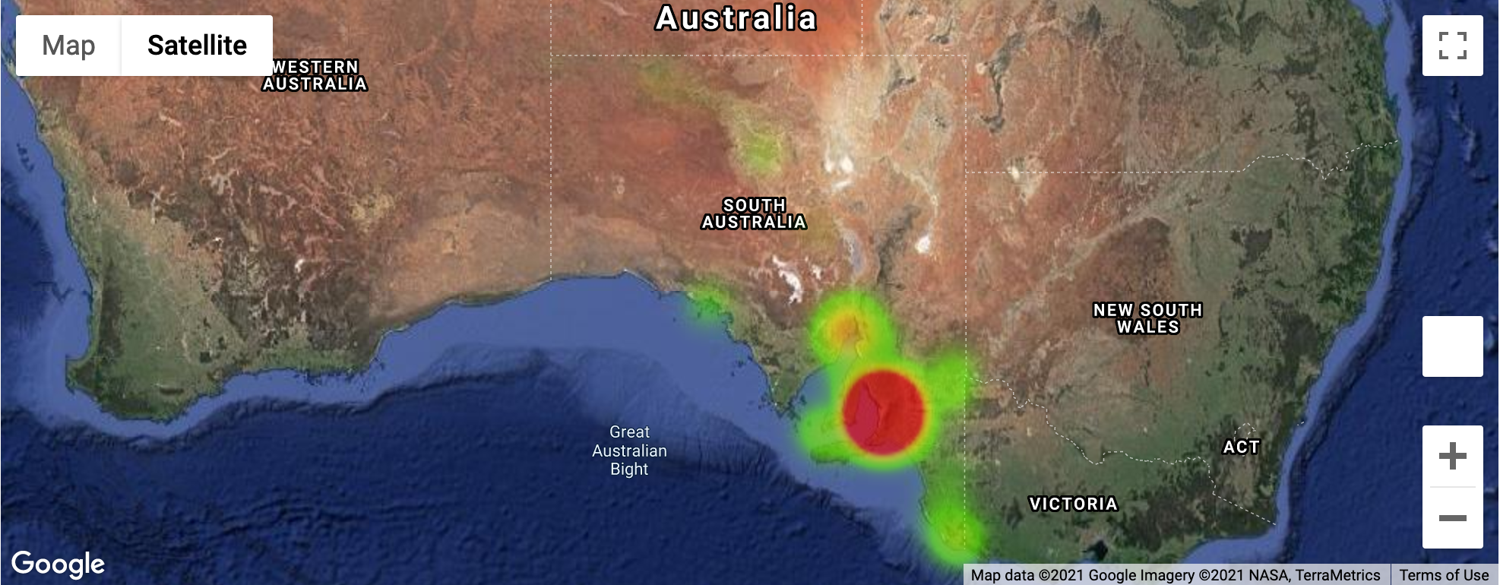
Crime Heatmap 2019

Slide 10
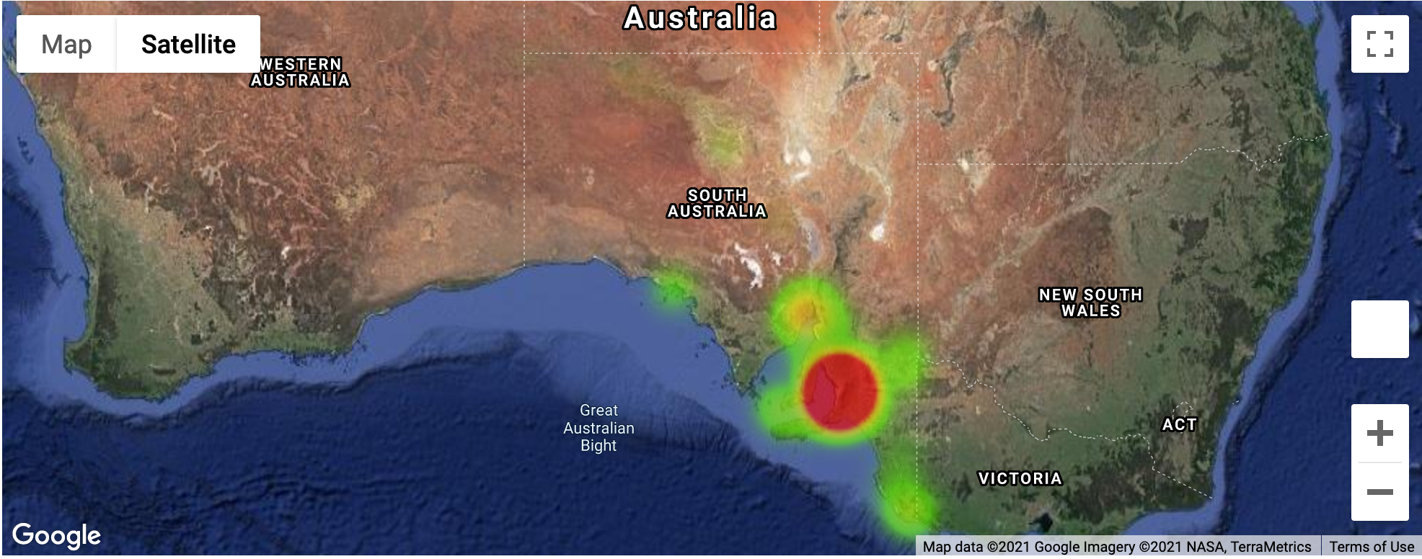
Crime Heatmap 2020

Slide 11
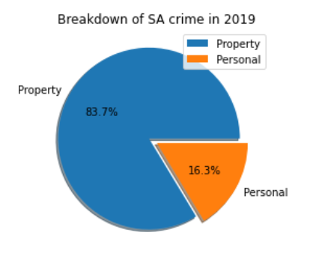
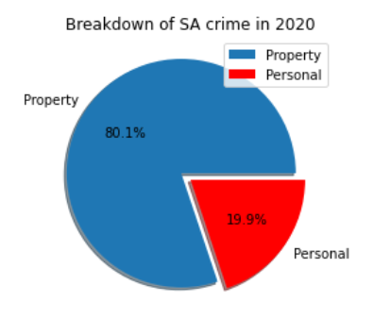
Breakdown of SA Crimes by Offence Type

Slide 12

Personal Crime Heatmap 2019

Slide 13
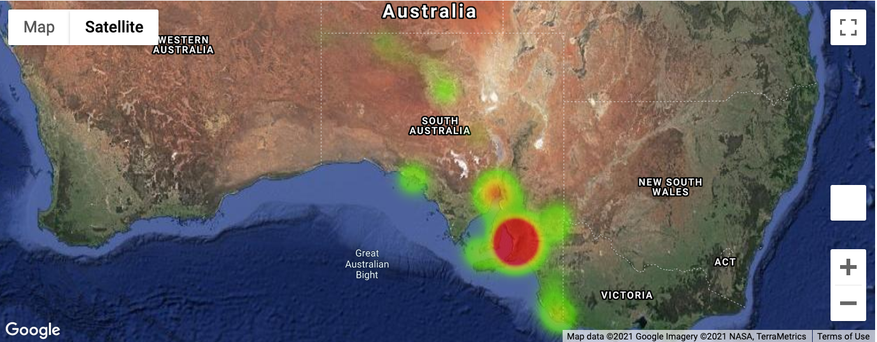
Personal Crime Heatmap 2020

Slide 14
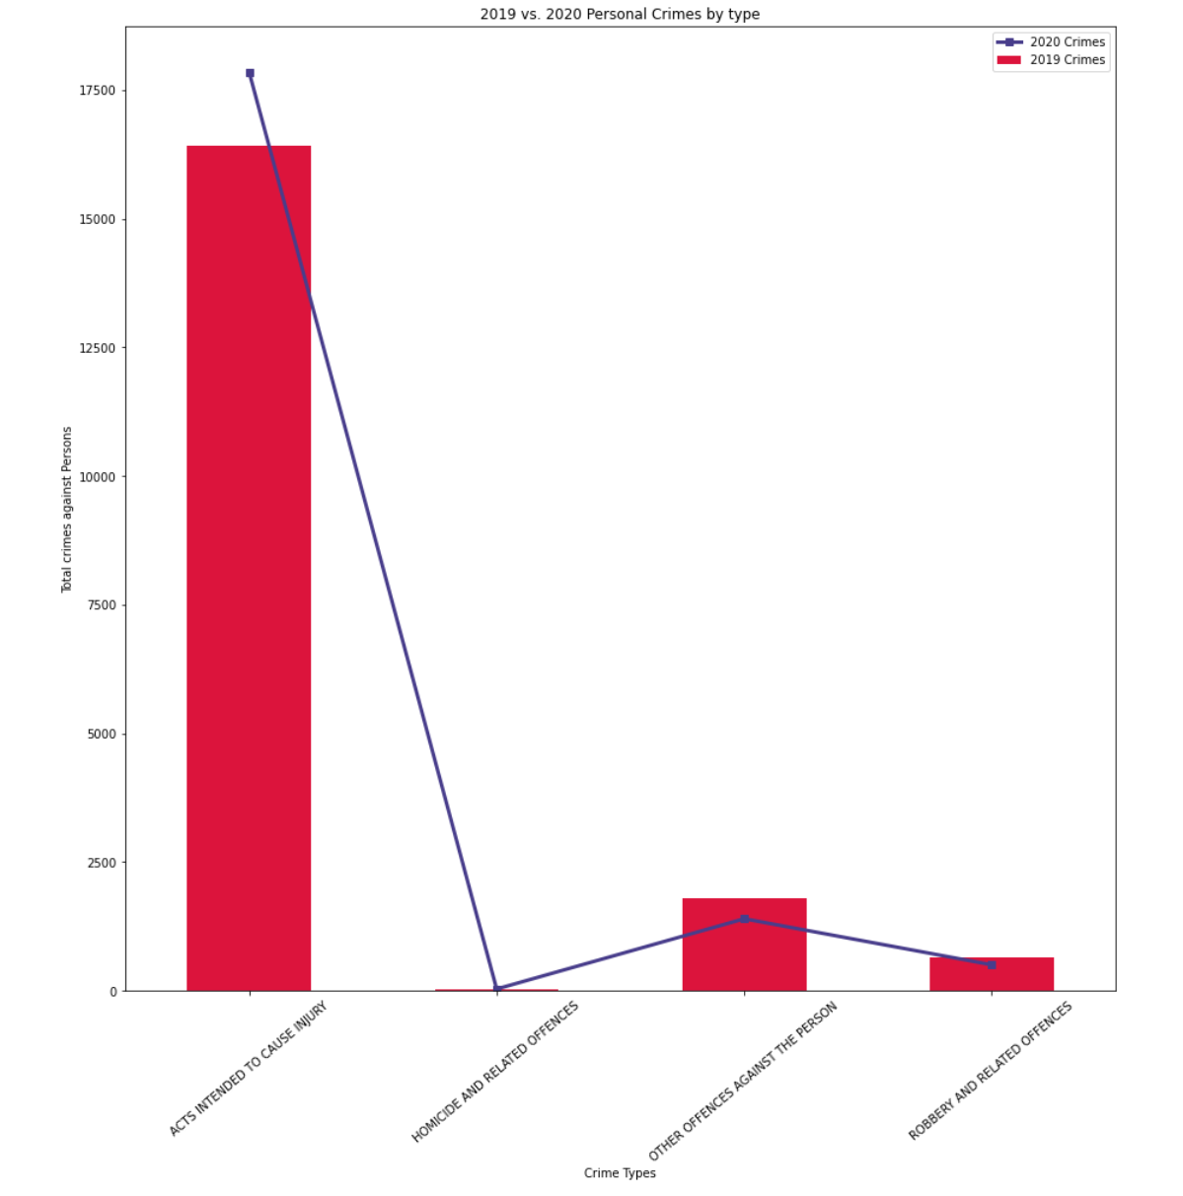
Personal Crimes by Offence Type 2019 vs. 2020

Slide 15
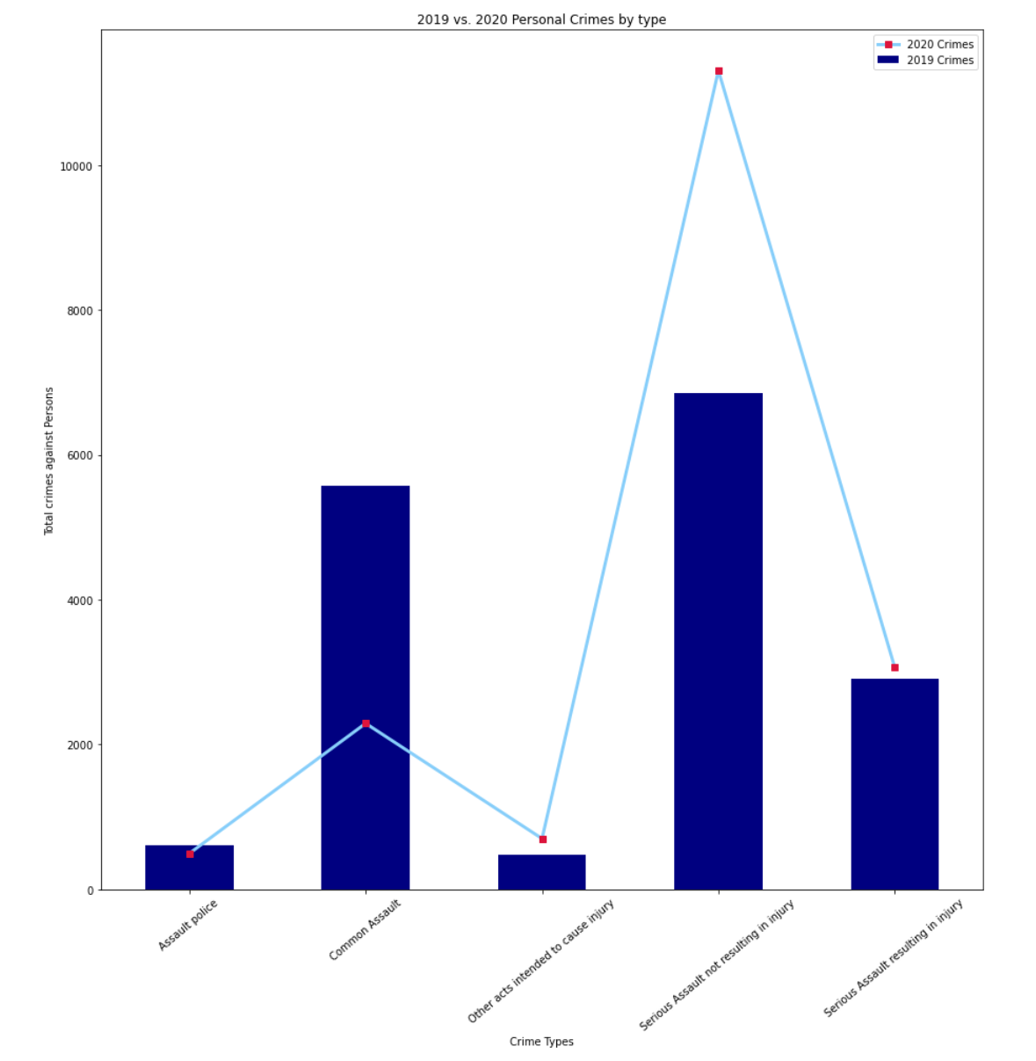
Acts intended to cause injury 2019 vs. 2020

Slide 16
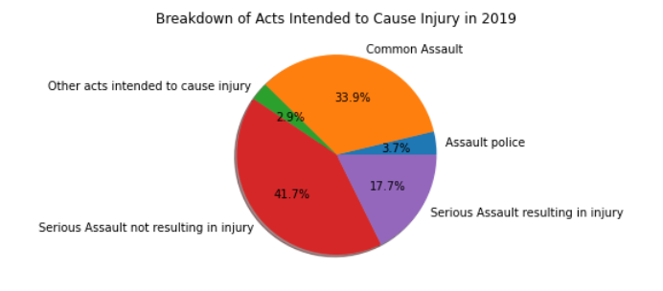
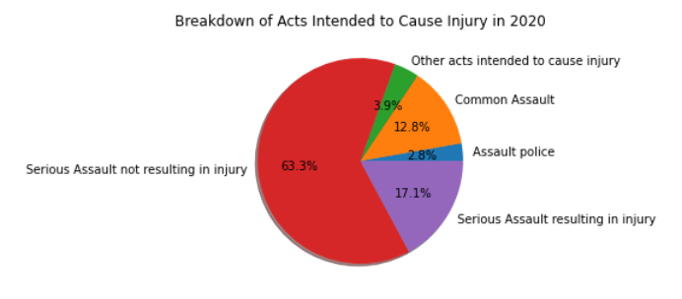
Breakdown of Acts Intended to Cause Injury 2019 vs. 2020

Slide 17
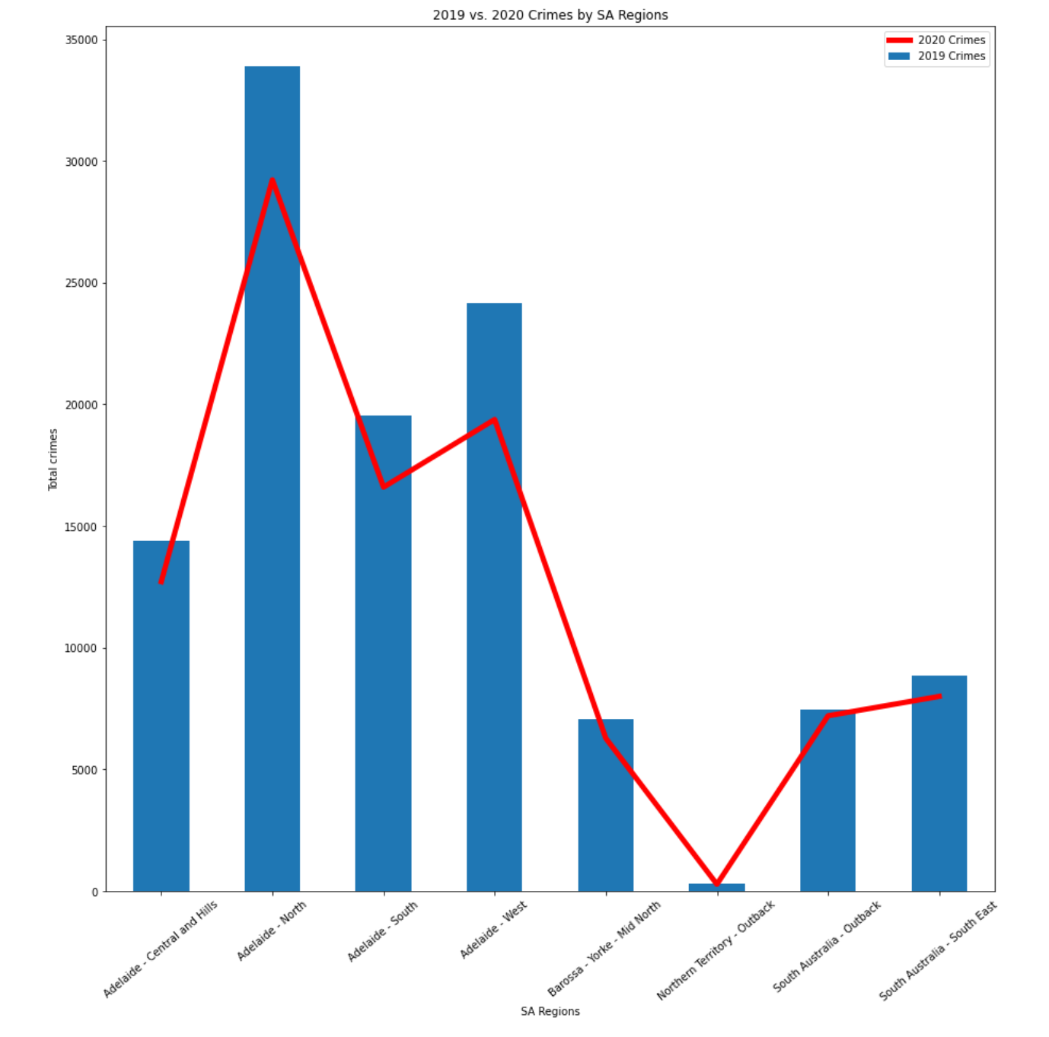
Crimes by SA Regions 2019 vs. 2020

Slide 18
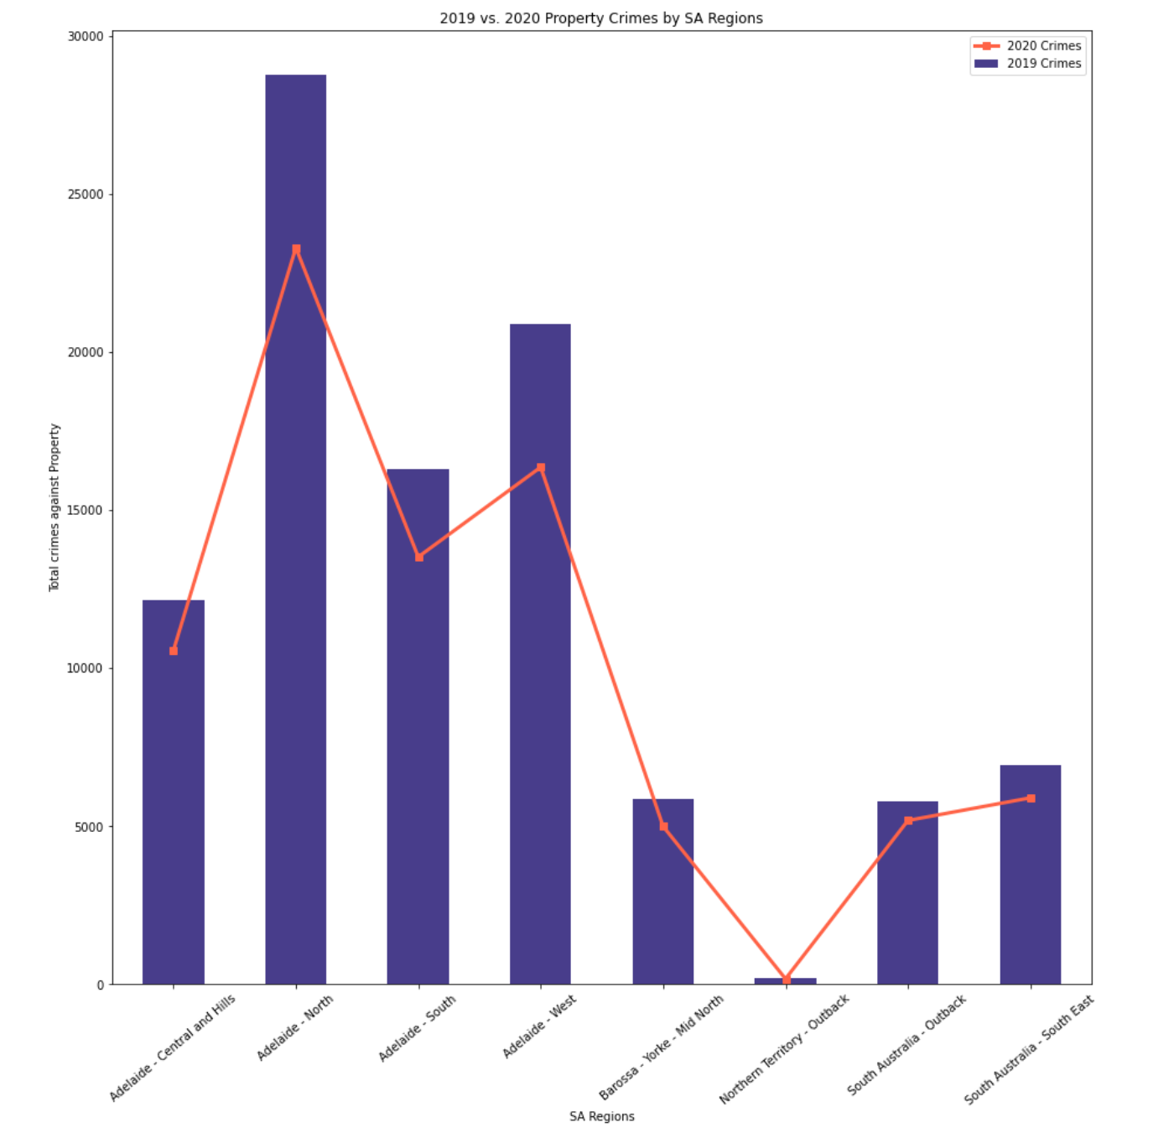
Property Crimes by SA Regions 2019 vs. 2020

Slide 19
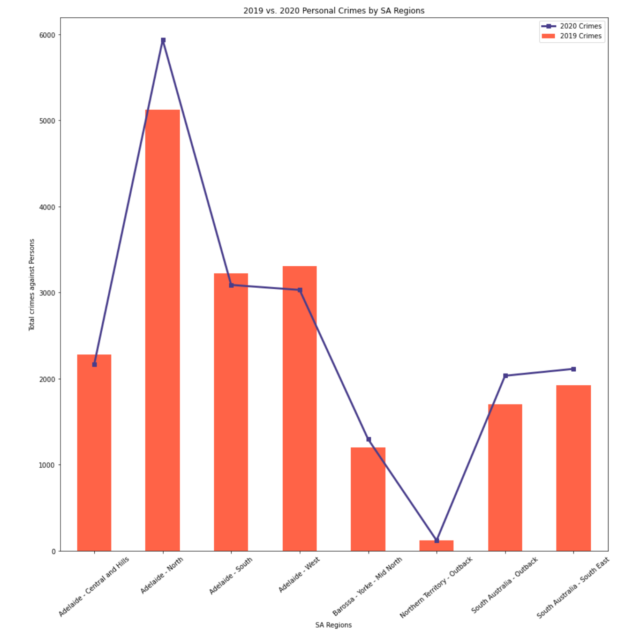
Personal Crimes by SA Regions 2019 vs. 2020

Slide 20
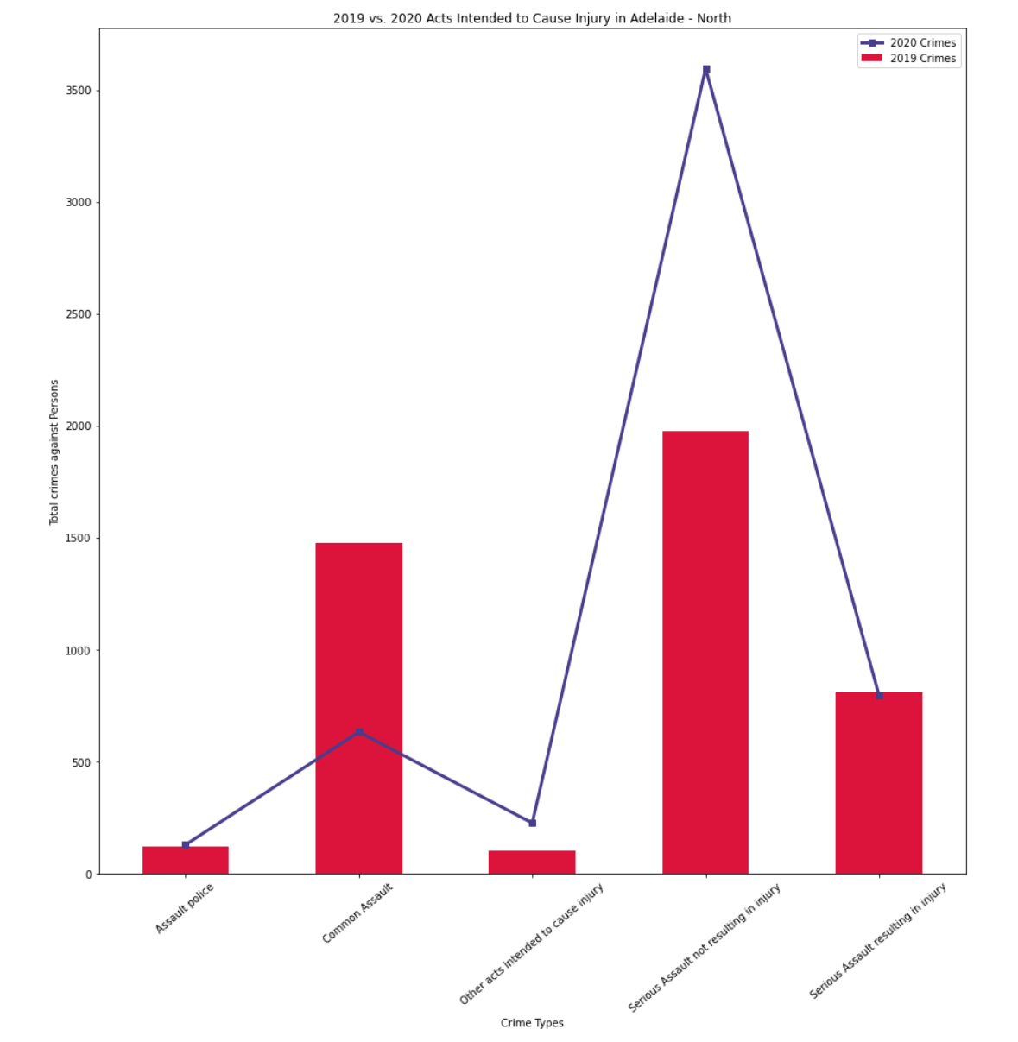
Acts Intended to Cause Injury: Adelaide – North 2019 vs. 2020

Slide 21
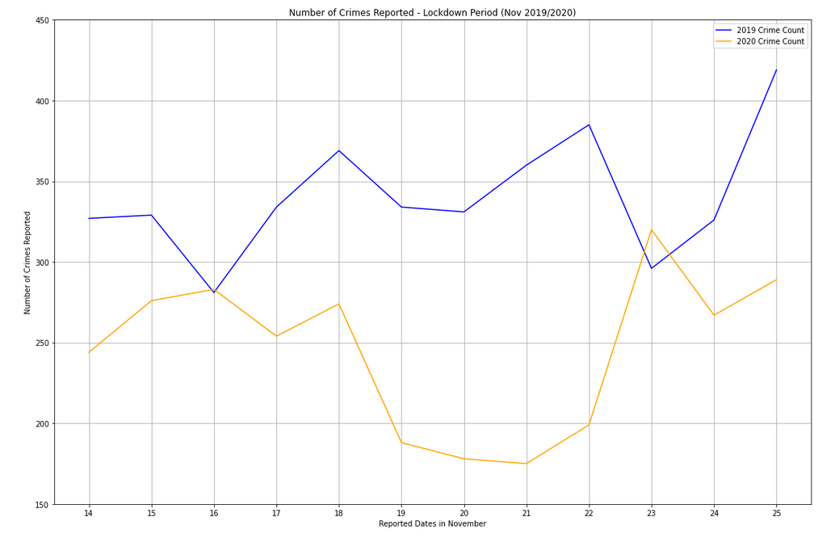
Total Crimes Over Lockdown

Slide 22
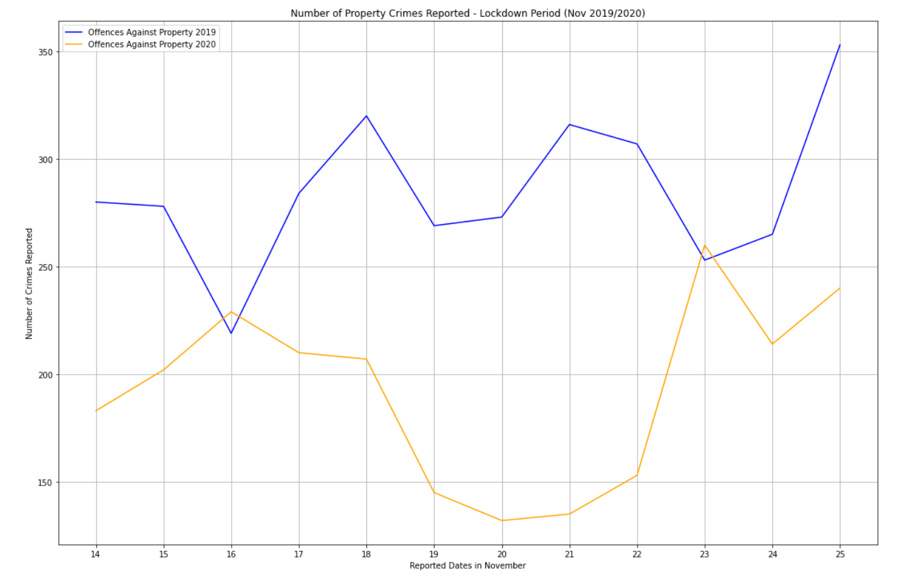
Property Crimes Over Lockdown

Slide 23
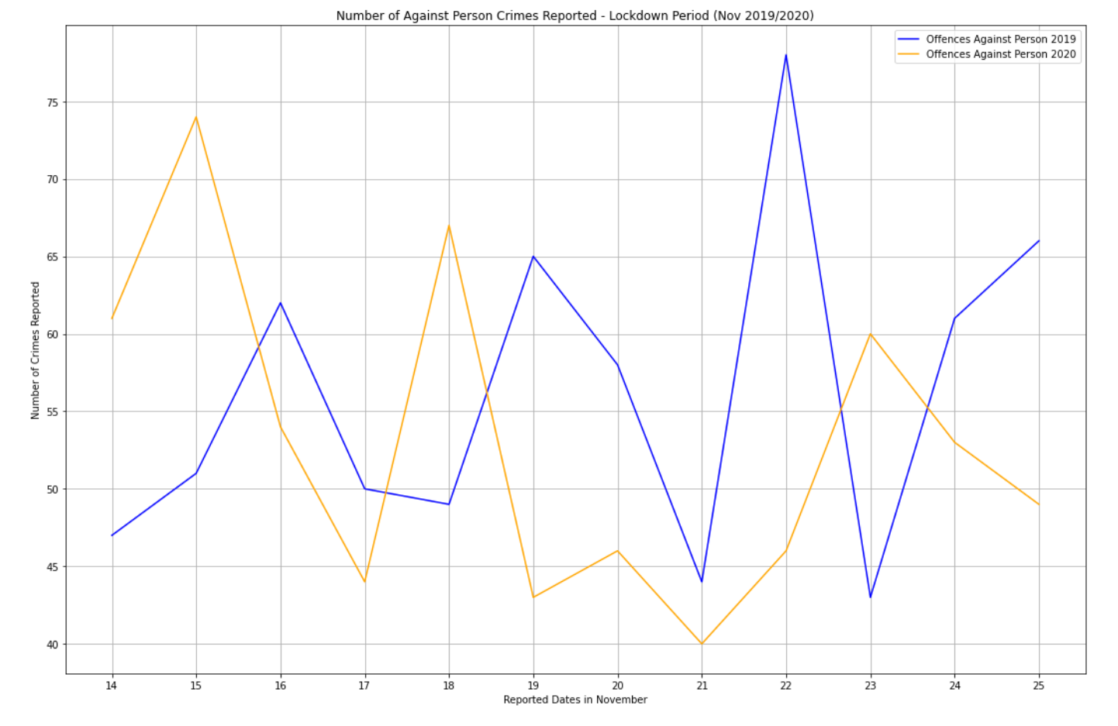
Against Person Crimes Over Lockdown

Slide 24
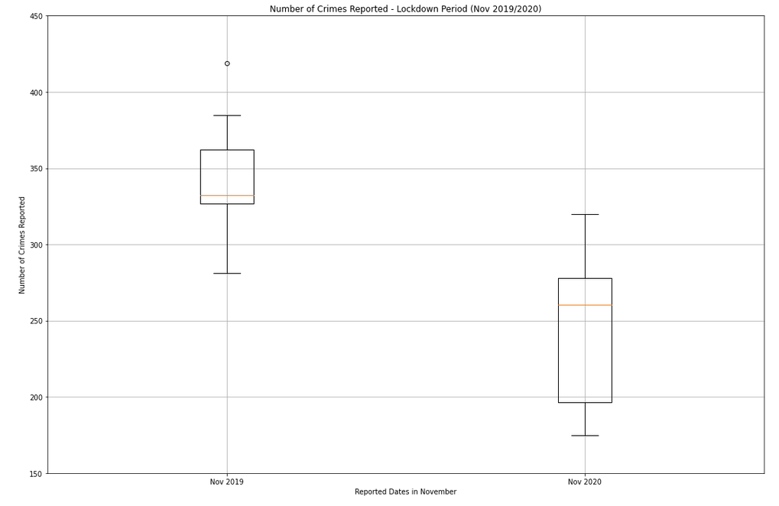
Total Crime Over Lockdown IQR Breakdown

Slide 25
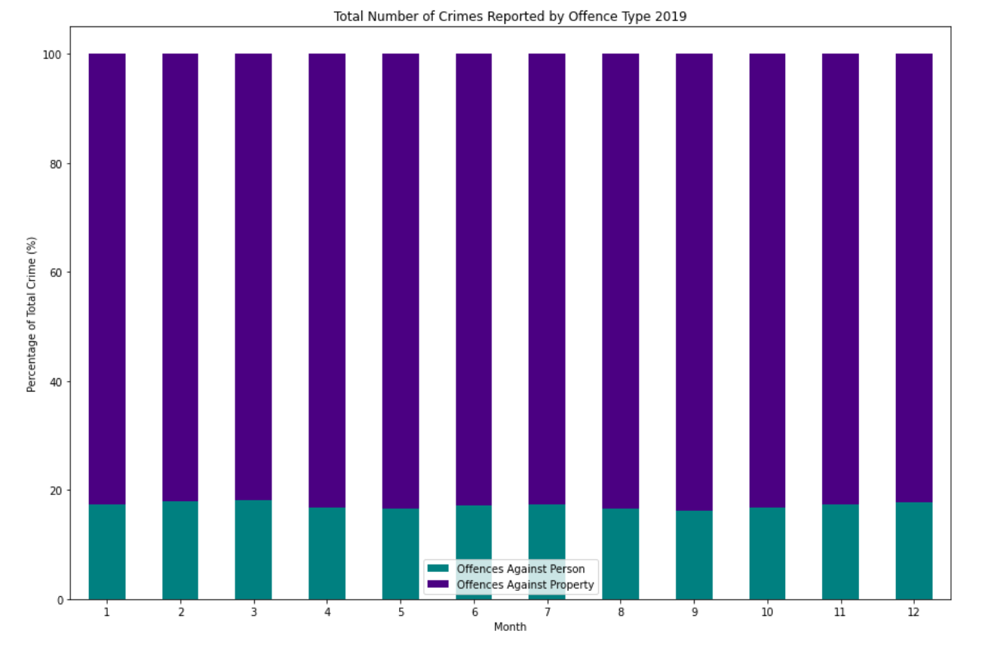
Crime Offence Percentage Breakdown 2019

Slide 26
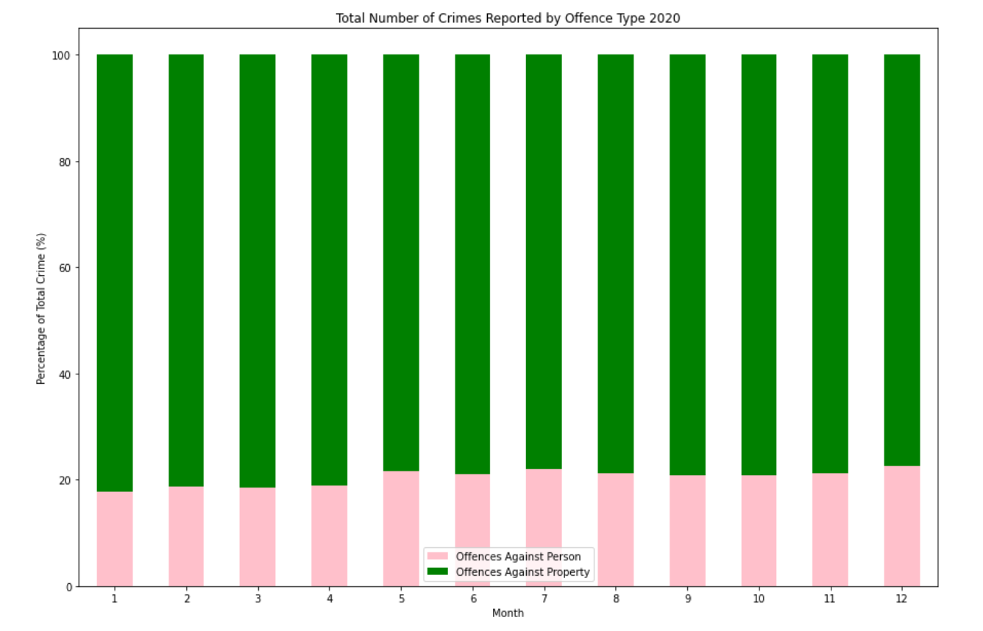
Crime Offence Percentage Breakdown 2020

Slide 27
Response from SA Government
30th April 2020
$2.4 million fund for domestic violence hotline
10th June 2020
$600,000 allocated to target domestic violence during the coronavirus pandemic.
$500,000 for domestic violence scheme
$100,000 at-risk women domestic violence services

Slide 28
Questions

